Slide 1
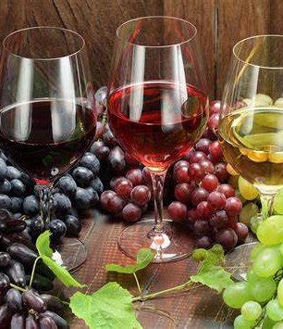
D-Wine!
Analysis of wines at Winex Corp
- Win Consultants
December , 2020
Notes:
Line spacing + Page numbers

Slide 2
Agenda
01 Problem Statement
02 Analysis
03 Recommendations
04 Next steps

Slide 3
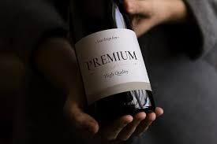
Problem Statement
01
Winex has been operating in the French wine market for the past 15 years and is keen to increase market share by improving their wine quality
Winex would now wish to understand what are the mix of key ingredients that would help Winex produce best quality wines.

Slide 4
Analysis
02

Slide 5
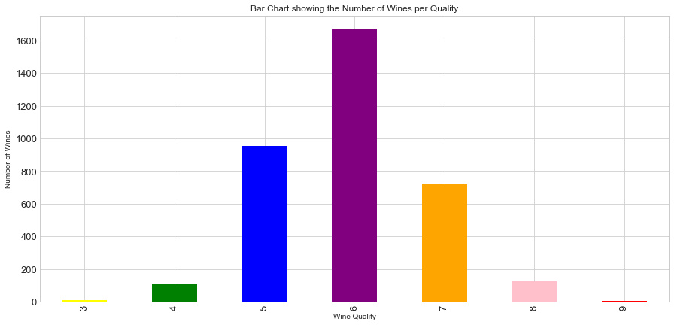
Qualities of Wines
Winex produces 7 unique qualities of wine from Quality 3(low quality) to Quality 9(high quality)
Quality 6 followed by Quality 5 are most produced (1670 and 954 wines respectively)
Very few high qualities wines are produced (Winex produces only 5 of Quality 9 and 124 of Quality 8)

Slide 6
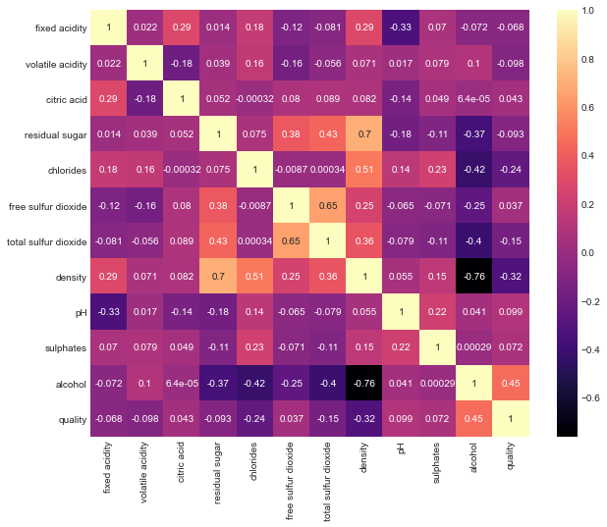
Heat Map of various ingredients
Alcohol is positively correlated with wine quality and alcohol content has the biggest impact on the quality of wine (correlation coefficient 0.45)
Strong negative correlation between alcohol content and the density of wine(-0.76).
Strong positive correlation(0.65) between free sulfur dioxide and total sulfur dioxide.
High positive correlation(0.7) between residual sugar and density of wine

Slide 7
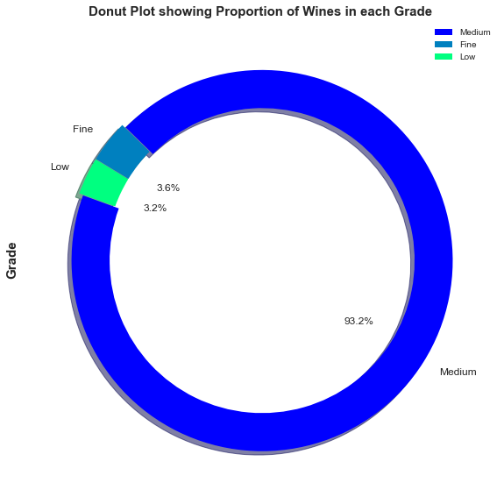
Categories of Wines
Creation of 3 Grades of wine – Low(upto 4), Medium(upto 7) and Fine(8 and above)
Winex produces 93.2% of Medium wines (3342 wines), followed by 3.6% of Fine wines(129 wines) and 3.2% of Low grade wines(113 wines)

Slide 8
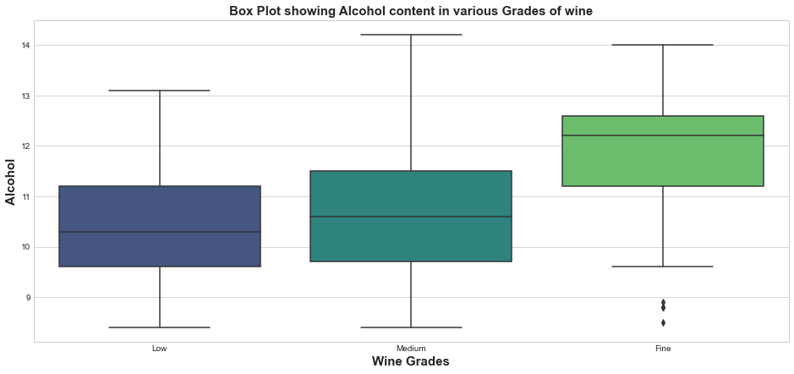
Alcohol analysis
Alcohol content increases as the Wine Grade increases. The Fine wines have a far higher median amount of alcohol(approx. 12.2%) than Low and Medium Wines

Slide 9
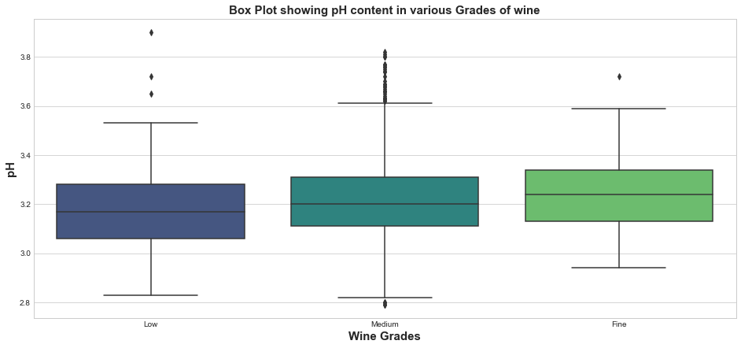
pH analysis
pH increases only slightly as the wine grade increases from Low to Fine Grade. It varies from a range of 3.1-3.3
More number of outliers at Medium Grade compared to those at Low and Fine Grade

Slide 10
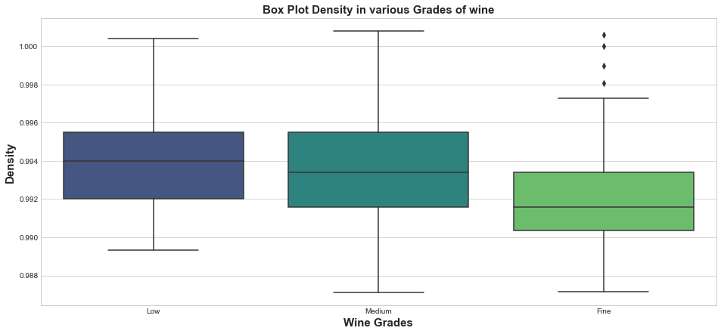
Density analysis
As the quality of wine increases, the density decreases. Fine grade wines that Winex produces has a median density of 0.9918 and Low Grade wines have density of 0.994.
Few outliers at higher level of density for Fine Grade wines

Slide 11
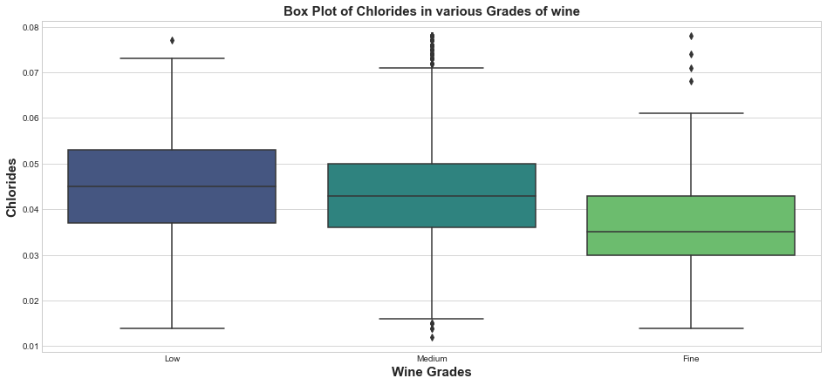
Chlorides analysis
Quantity of chlorides decreases slightly as the wine quality increases. Low wines have a median of 0.045g/L and fine wines have a median of 0.035g/L.

Slide 12
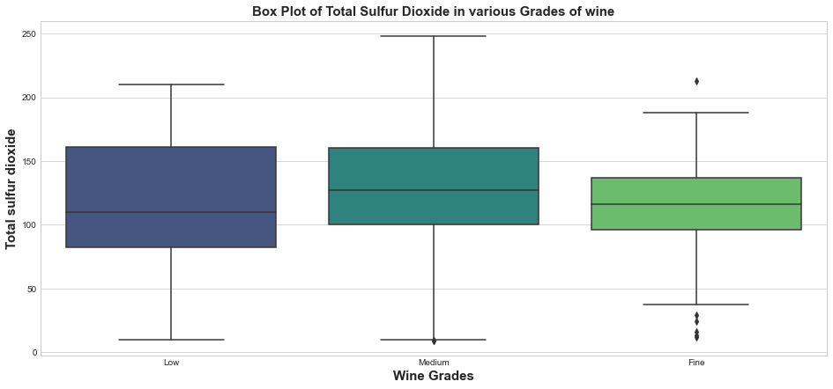
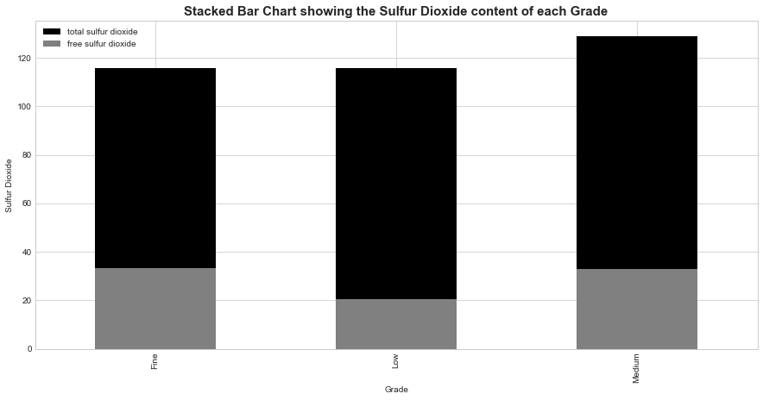
Total Sulfur Dioxide analysis
Largely Negative correlation between alcohol and total sulfur dioxide with Fine wines having very low variation
Free sulfur dioxide is directly correlated with Total Sulfur Dioxide and it’s proportion increases along with the wine Grade

Slide 13
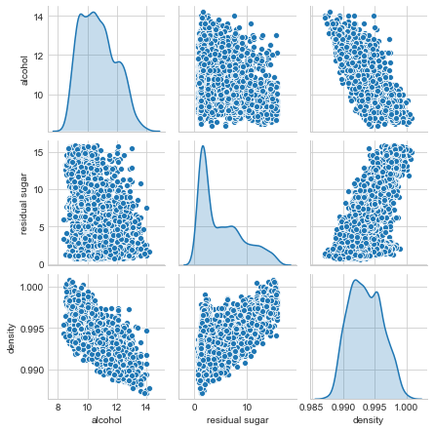
Analysis of Multiple Variables
Negative correlation between alcohol and density – wines that have more alcohol are less dense in nature
Positive correlation between residual sugar and density. Infact, residual sugar is one of the factors that contributes to increasing density

Slide 14
Recommendations
03

Slide 15

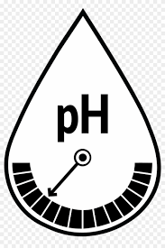

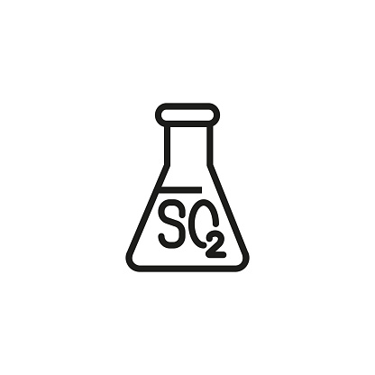

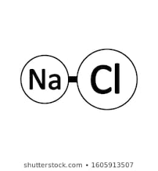
Ingredient
Strategy
Key Benefits
Alcohol
12-14 %
Bolder and Richer wine
Fuller flavour
Crisper taste
More consumption
pH
3.1 – 3.3
Density
0.99
Better alcohol content
Total Sulfur Dioxide
120mg/L
Antimicrobial quality
Anti-oxidant effect
Residual Sugar
2g/L
Wine stability
Prevent re-fermentation
Less salty taste
More customers
Chlorides
0.035g/L

Slide 16
Next steps
04

Slide 17

Sales data of Winex
To understand profitability of various Wine Grades
Market reports
Deep dive on wines that sell more in which markets

Slide 18
Thank you

